Slide 1

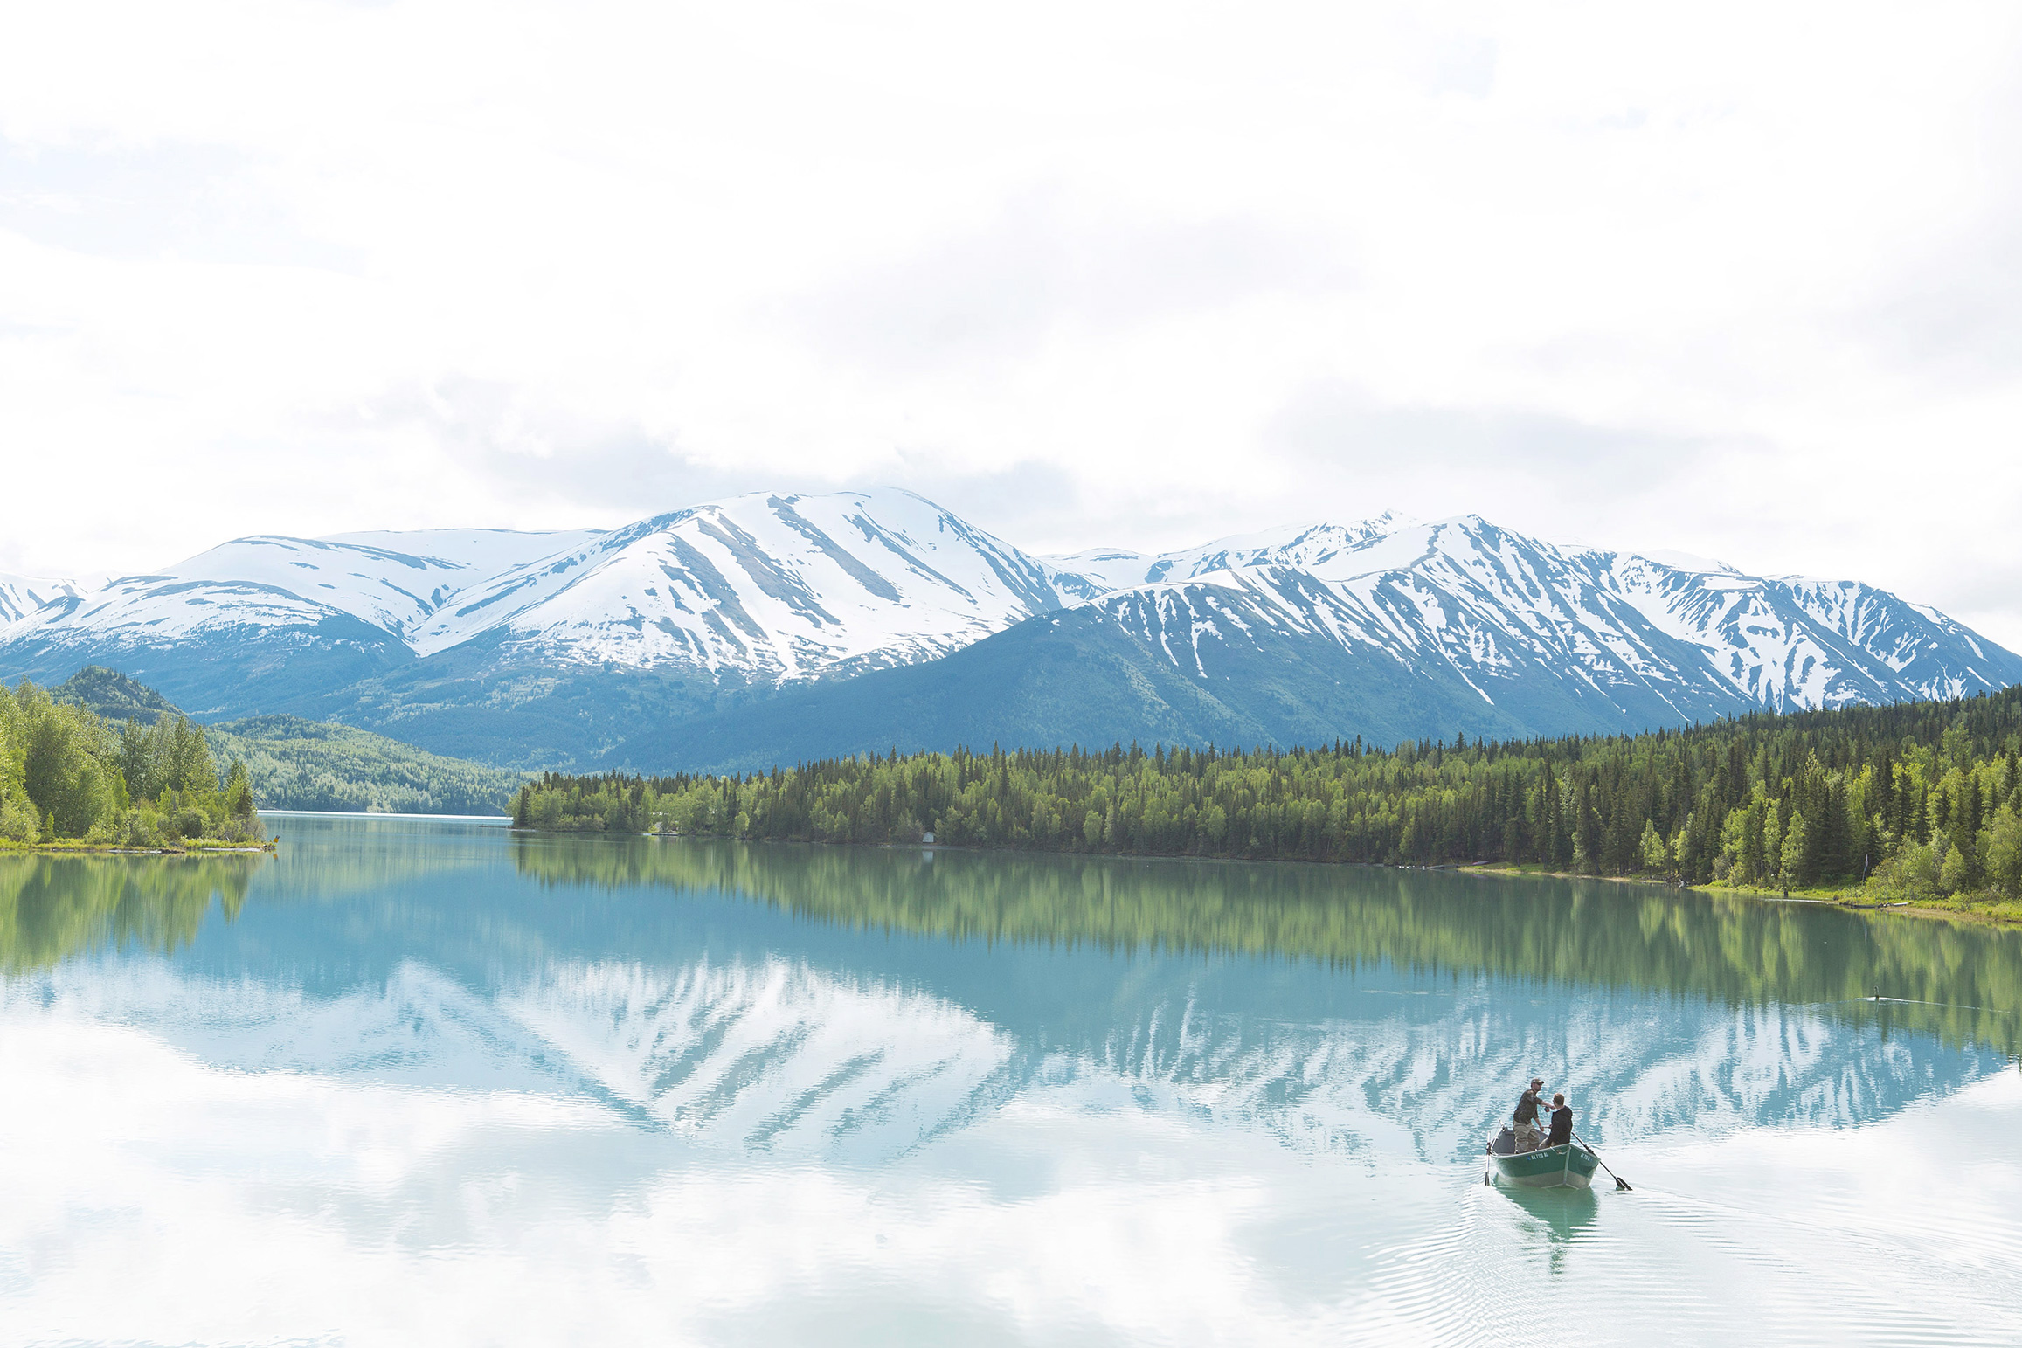
Notes:
overview of talk as well
One day you and your friends are talking about wanting to take a trip somewhere during spring break. Planning a trip is hard though. Searching the internet trying to find places to go can be annoying and boring. Why not make the whole experience fun? Welcome to uncharted an app that you can swipe through a lot of different options for any trip you might want to plan in an easy fun interactive way while saving them for future planning.

Slide 2
Mission Statement
“To simplify and improve travel planning by making new places that suit your needs easily discoverable.”

Slide 3
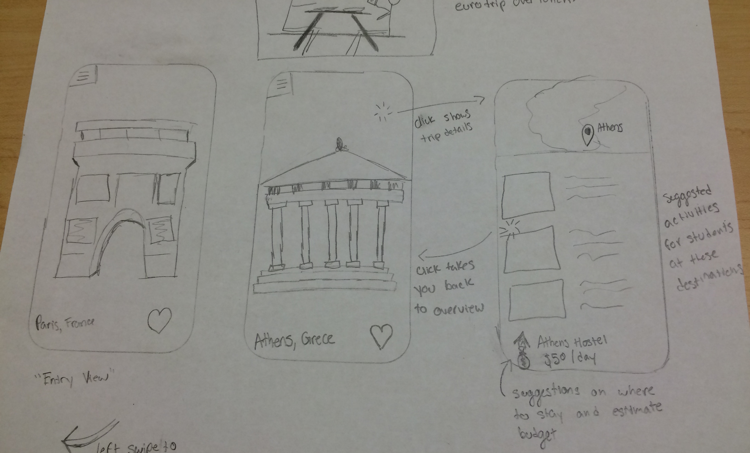
Simple Task
Notes:
Simple task is finding the details of each trip
tap the picture to find out things like the price, the location, or suggested activities to do in this location

Slide 4
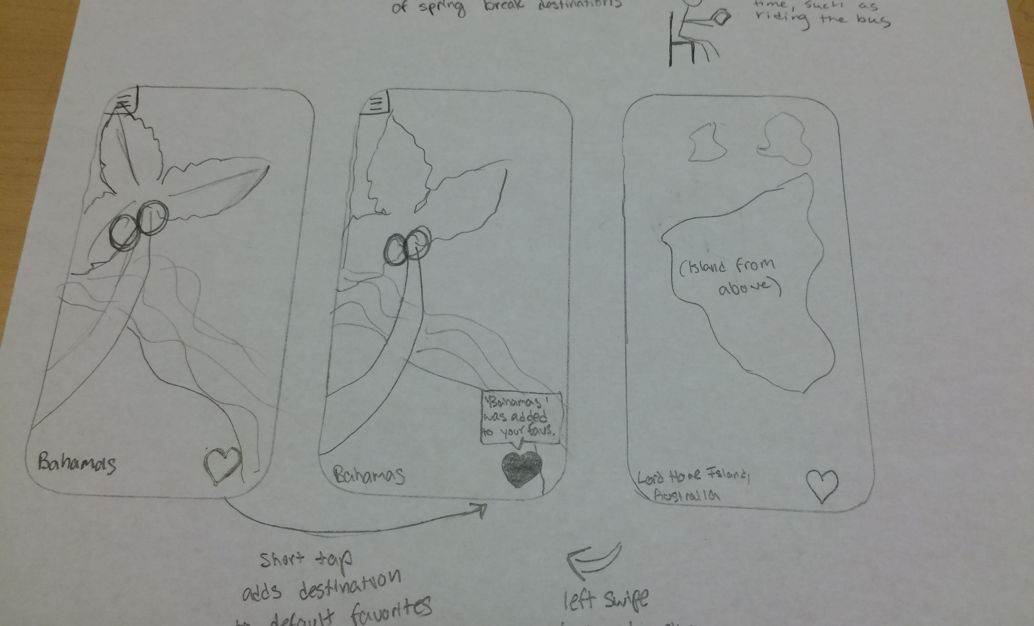
Moderate Task
Notes:
Moderate task is liking a trip
2 focuses
a—>regular tap in order to save the trip to the default wishlist
b—>long tap in order to save the trip to a specific list or make a new list

Slide 5
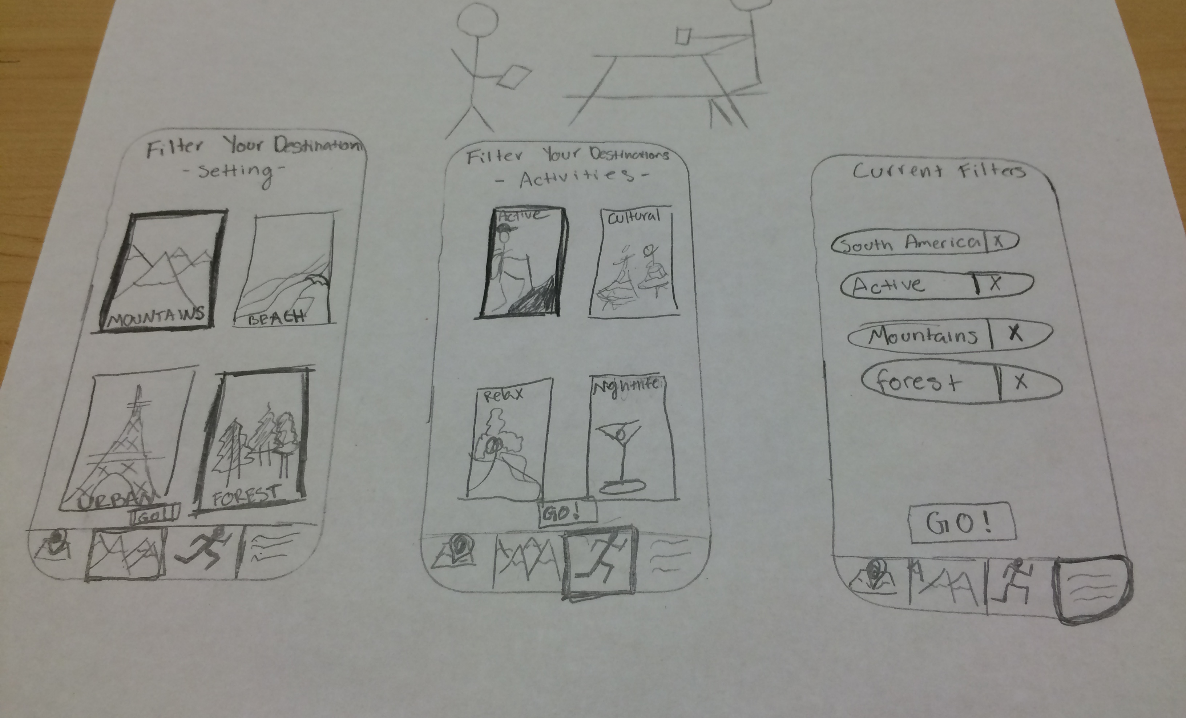
Complex Task
Notes:
Filter:
filter by geolocation(place in the world), by the setting(mountains, beach, urban), or by the activity (nightlife, relax, active—>hike, cultural)

Slide 6
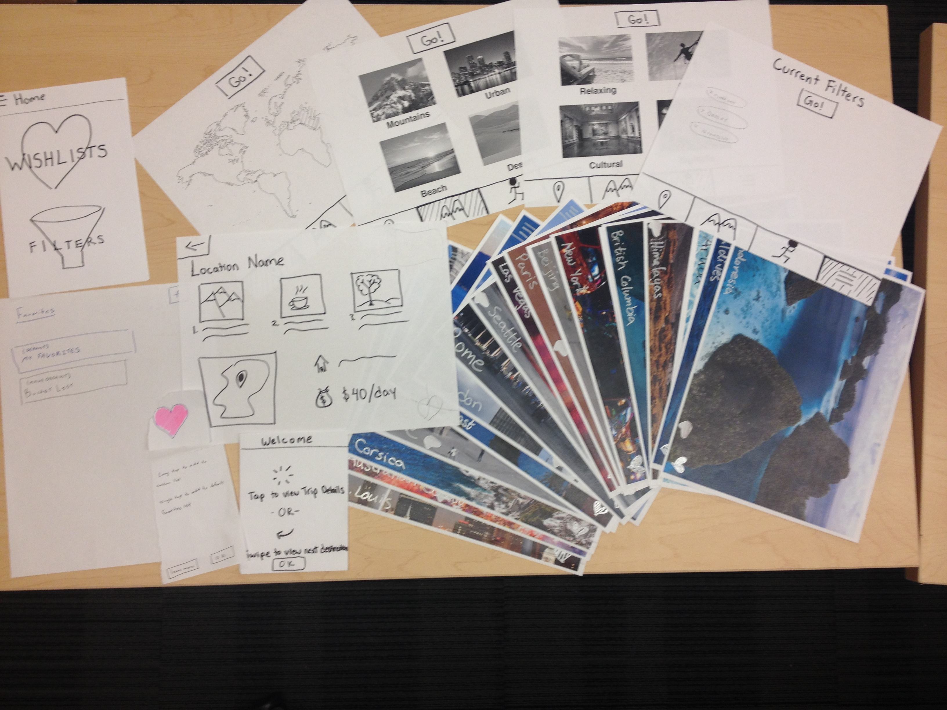
Notes:
collage of pictures
ability to favorite pictures
ability to go into wish lists
create new wish lists and see items in wishlist
ability to go into menu and see filters

Slide 7
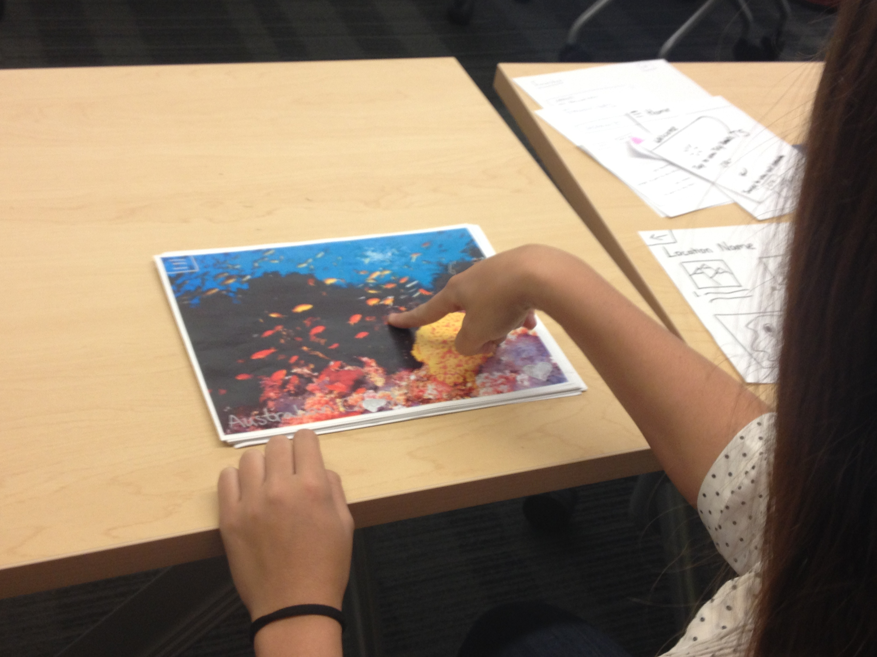
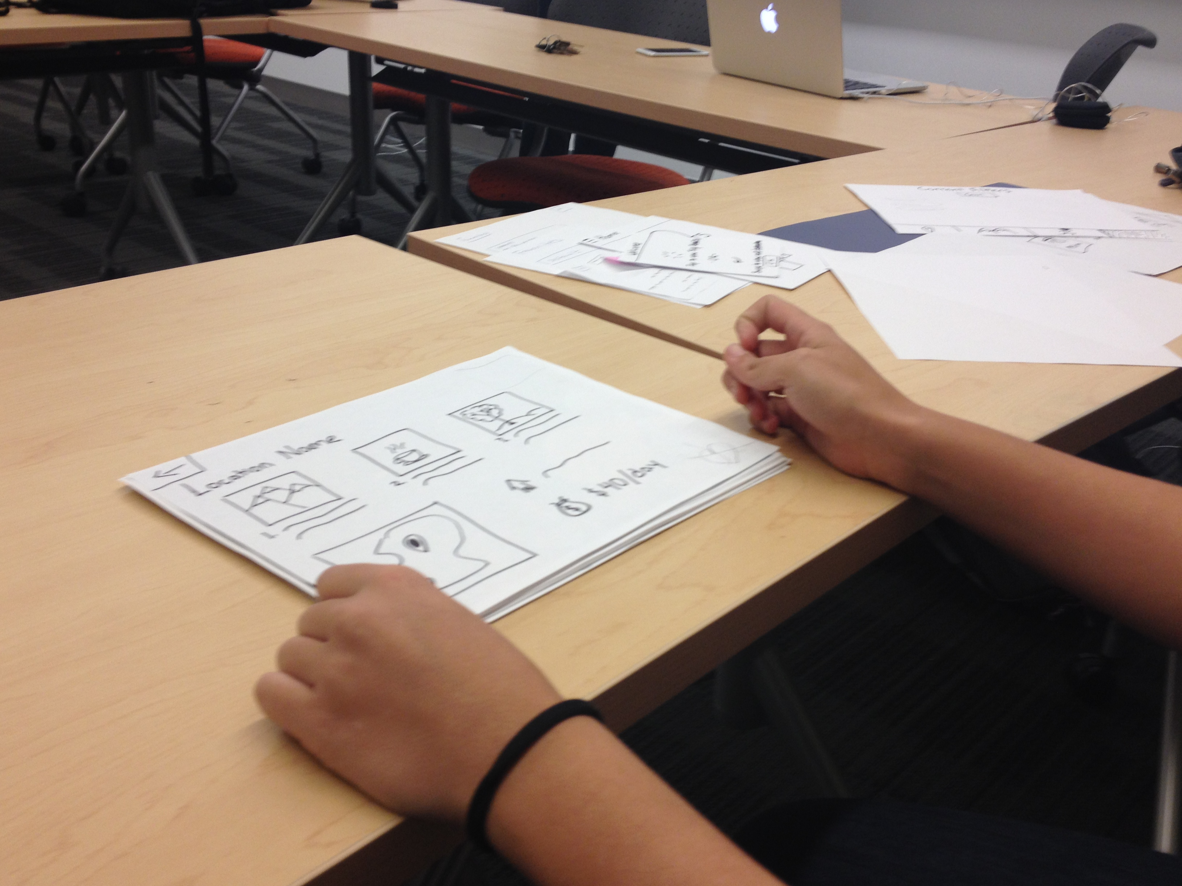
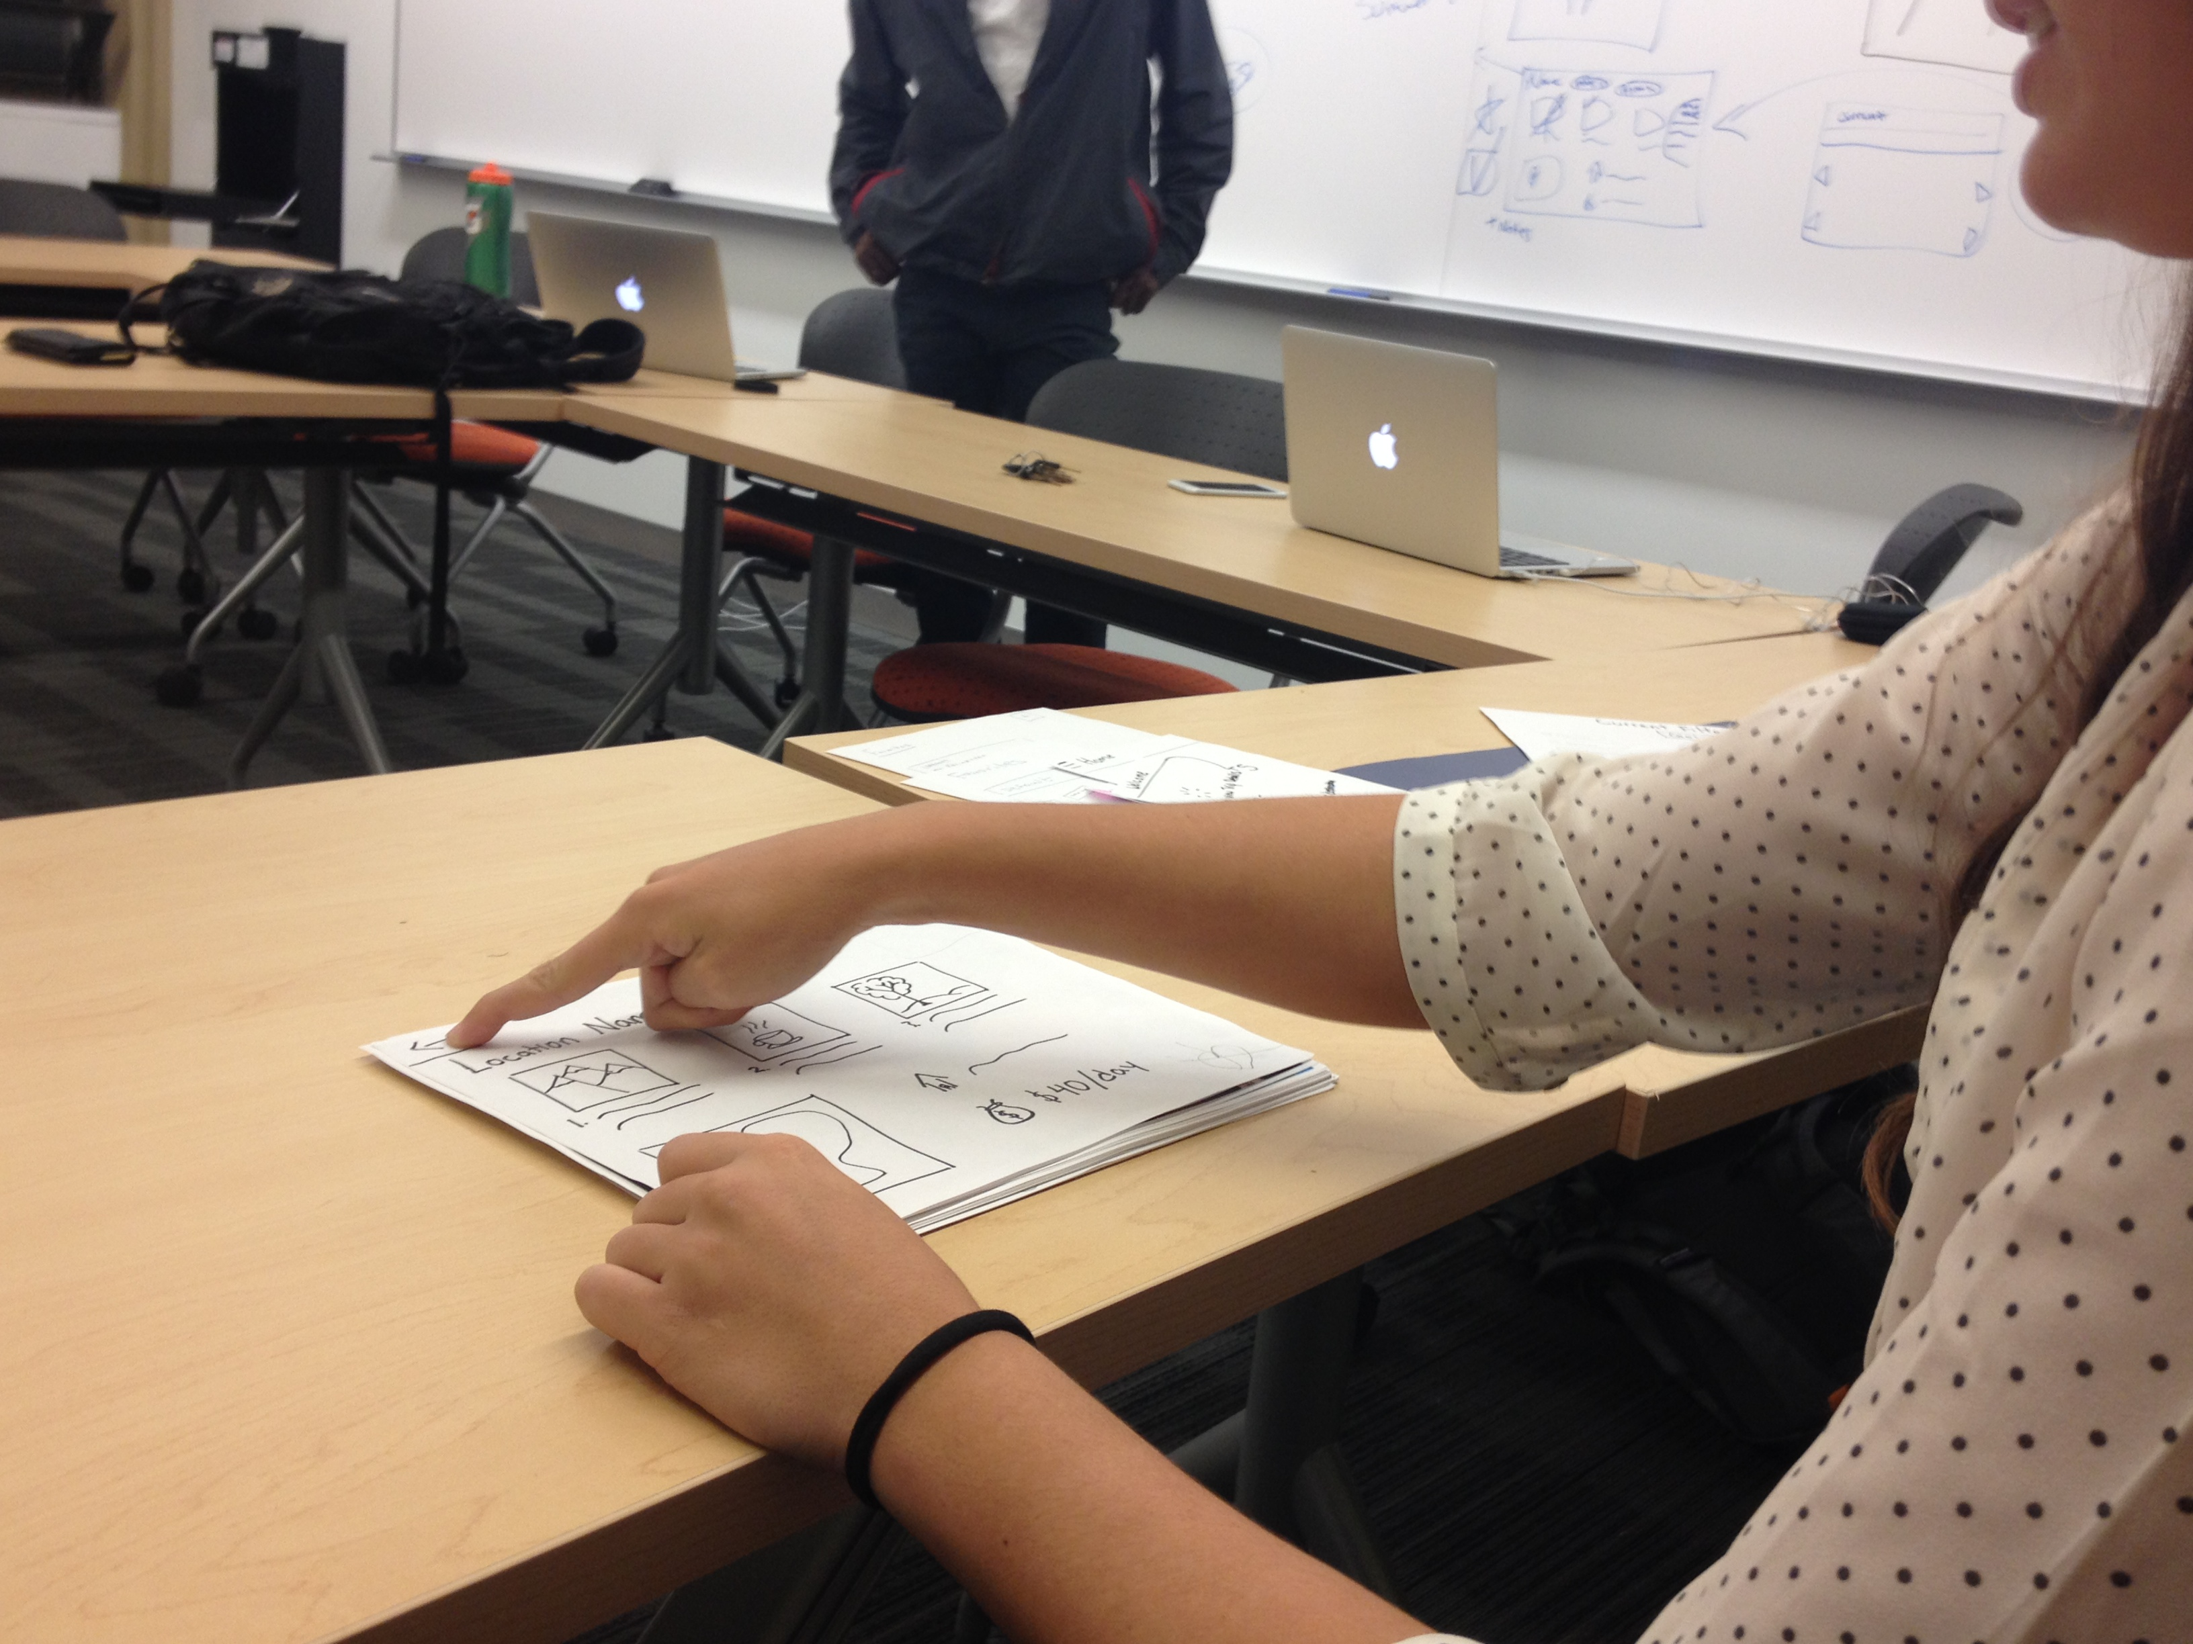
Notes:
Simple Task—> Details page

Slide 8
Notes:
collage of pictures
ability to favorite pictures
ability to go into wish lists
create new wish lists and see items in wishlist
ability to go into menu and see filters

Slide 9
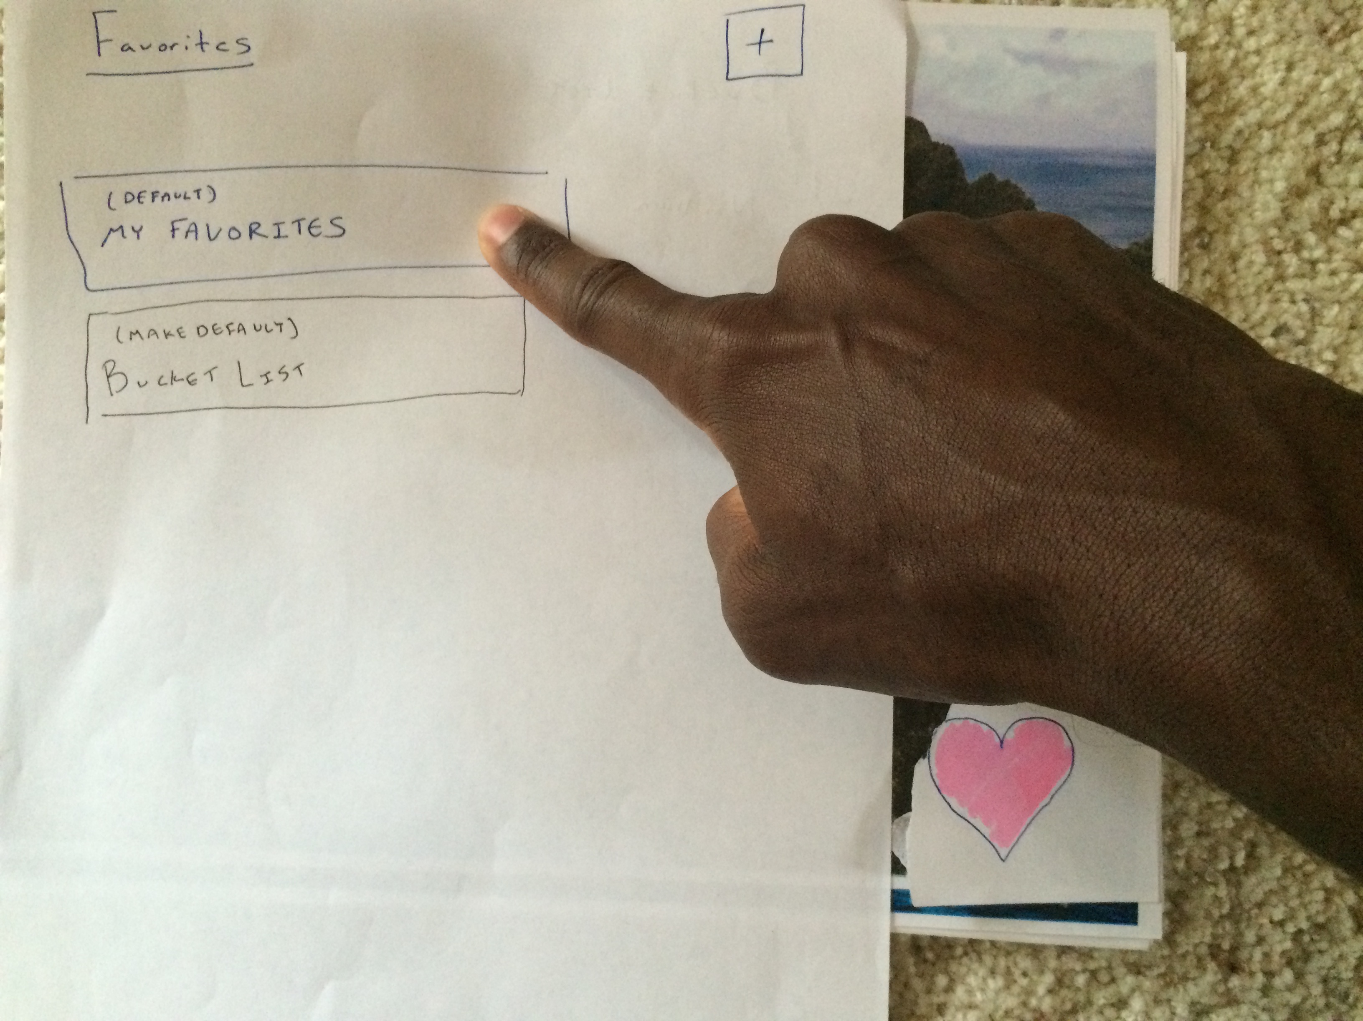
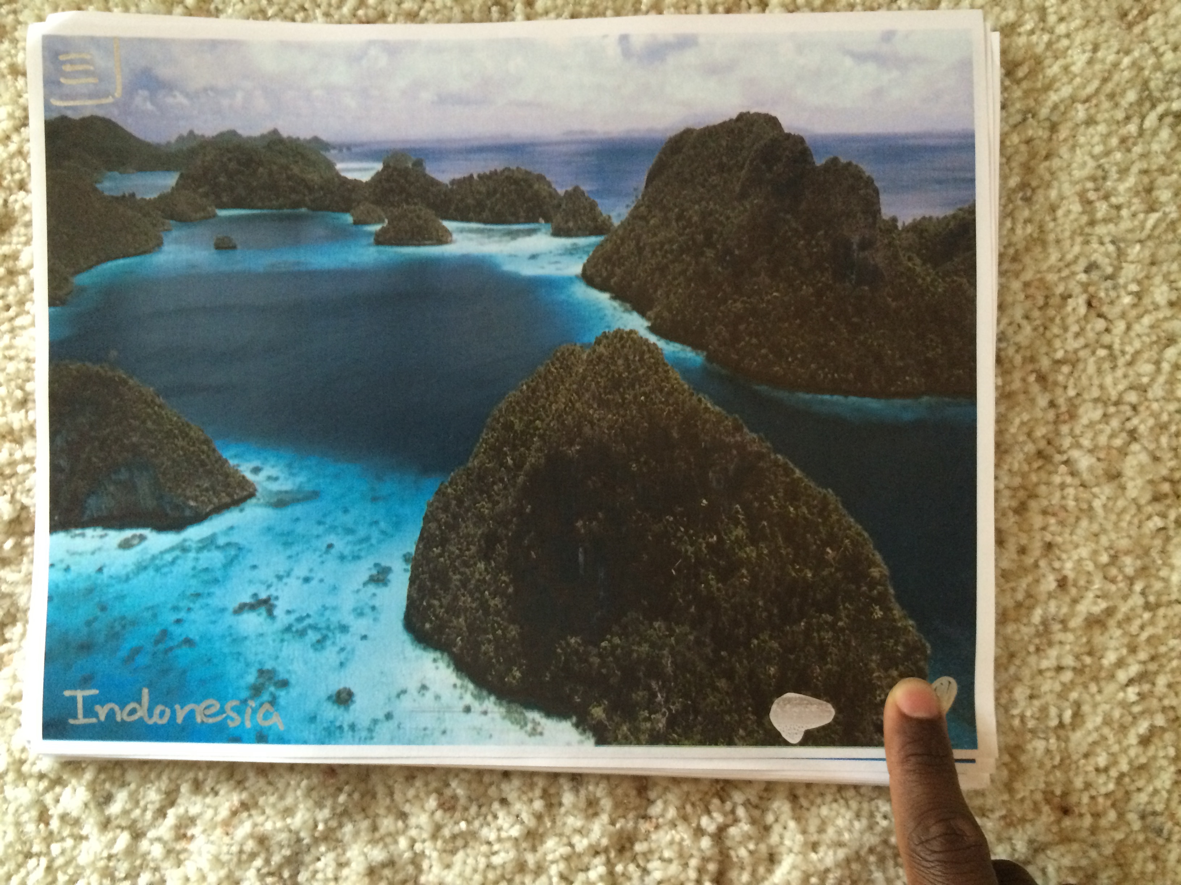
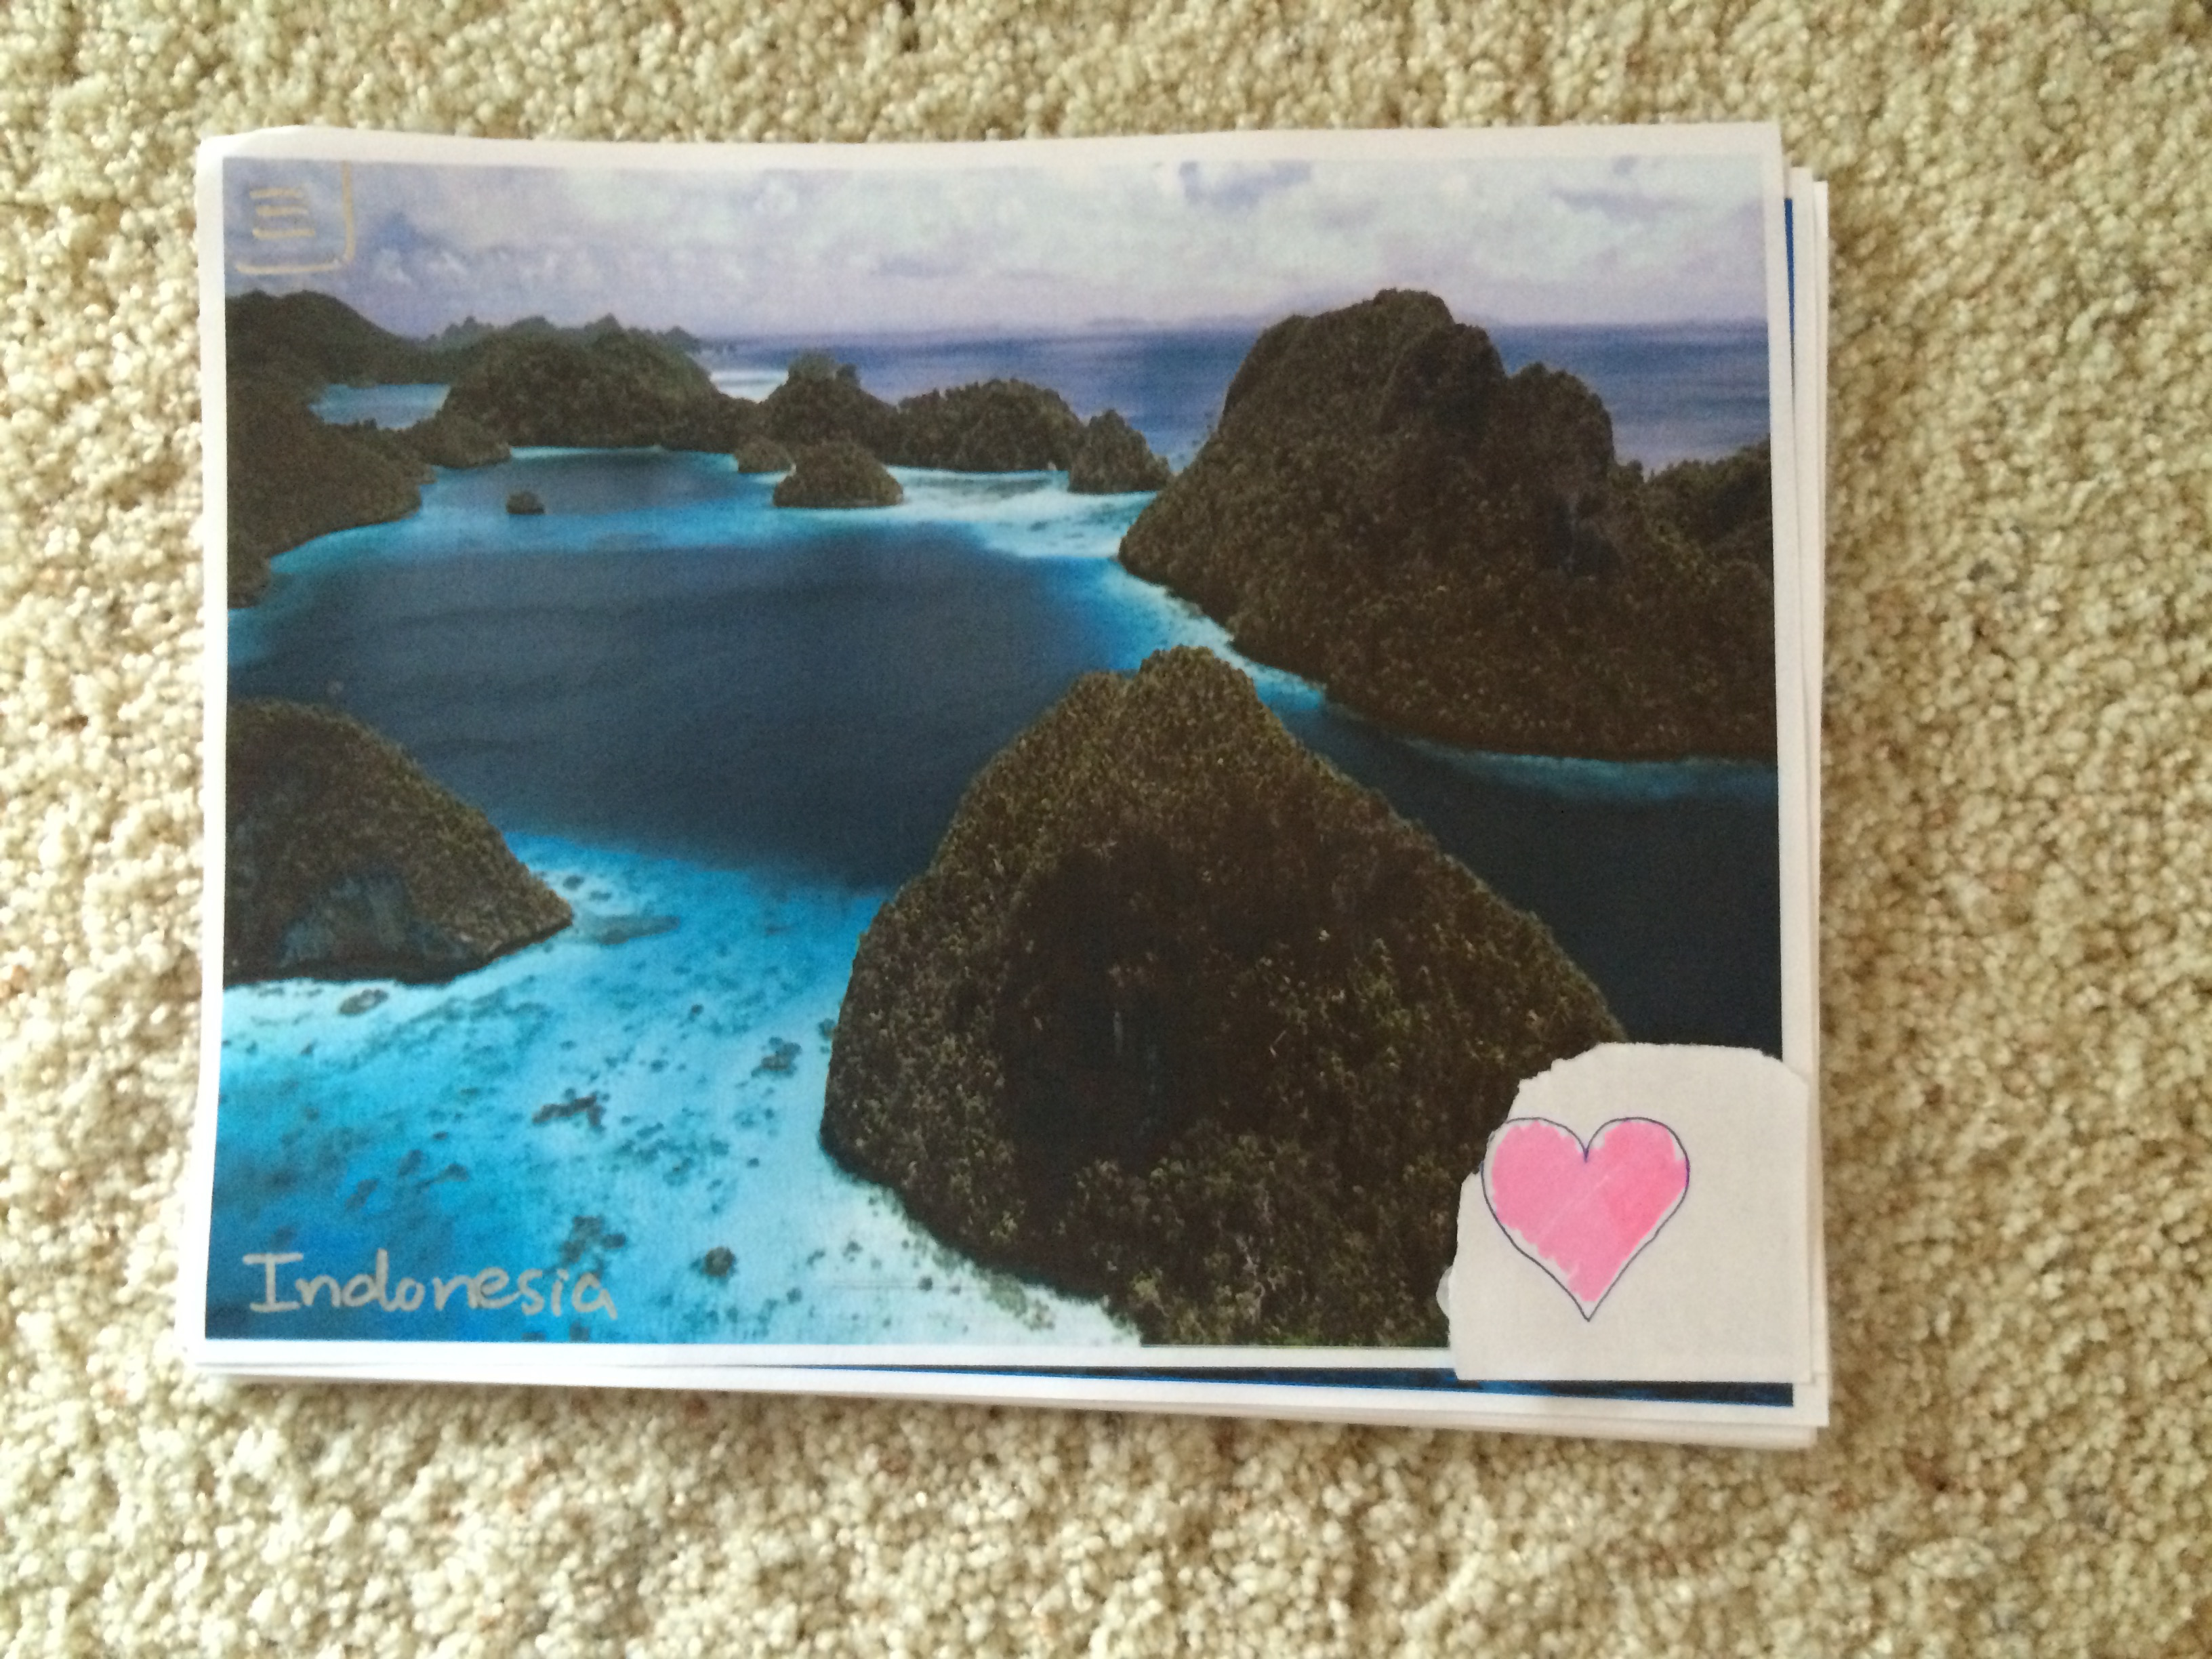
Notes:
Moderate Task—>favoriting and adding to a wishlist

Slide 10
Notes:
collage of pictures
ability to favorite pictures
ability to go into wish lists
create new wish lists and see items in wishlist
ability to go into menu and see filters

Slide 11
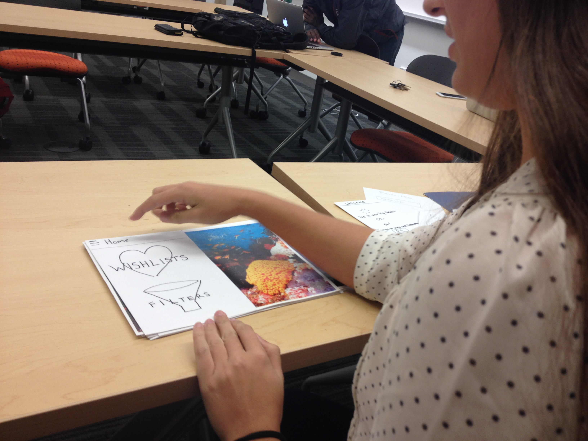
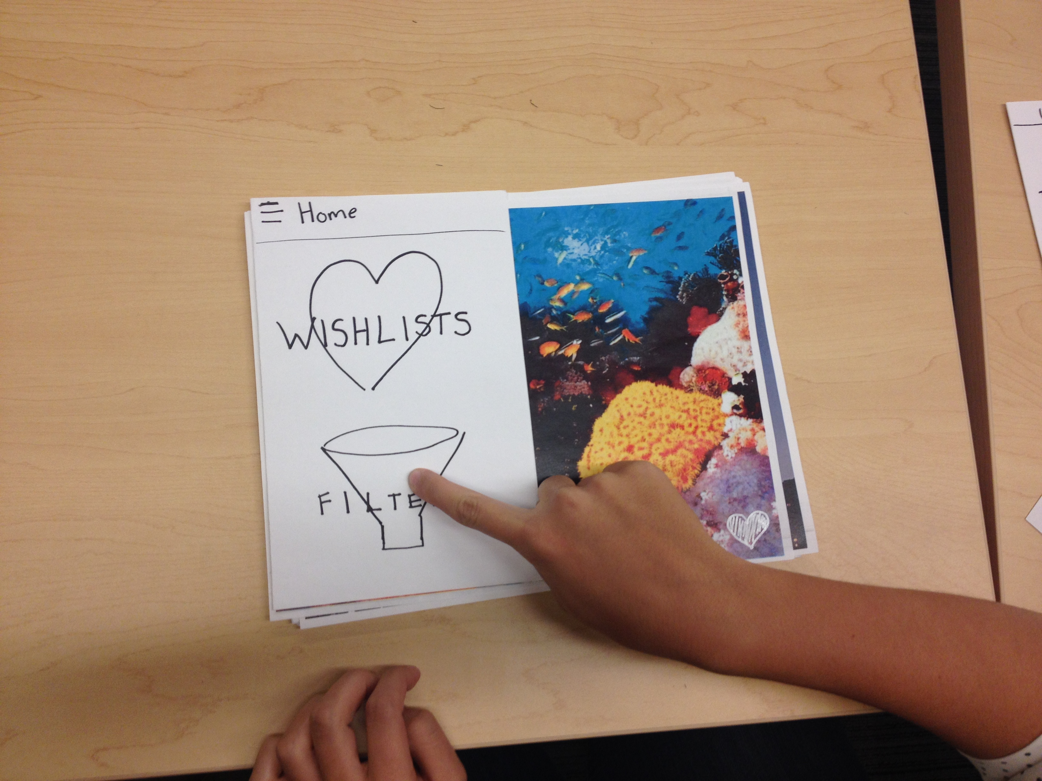
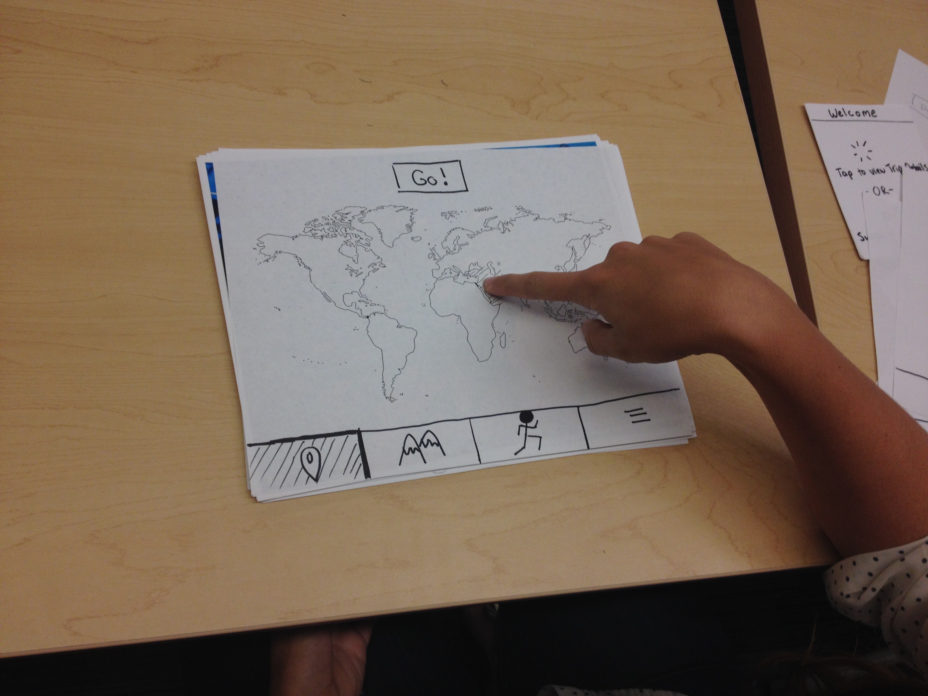
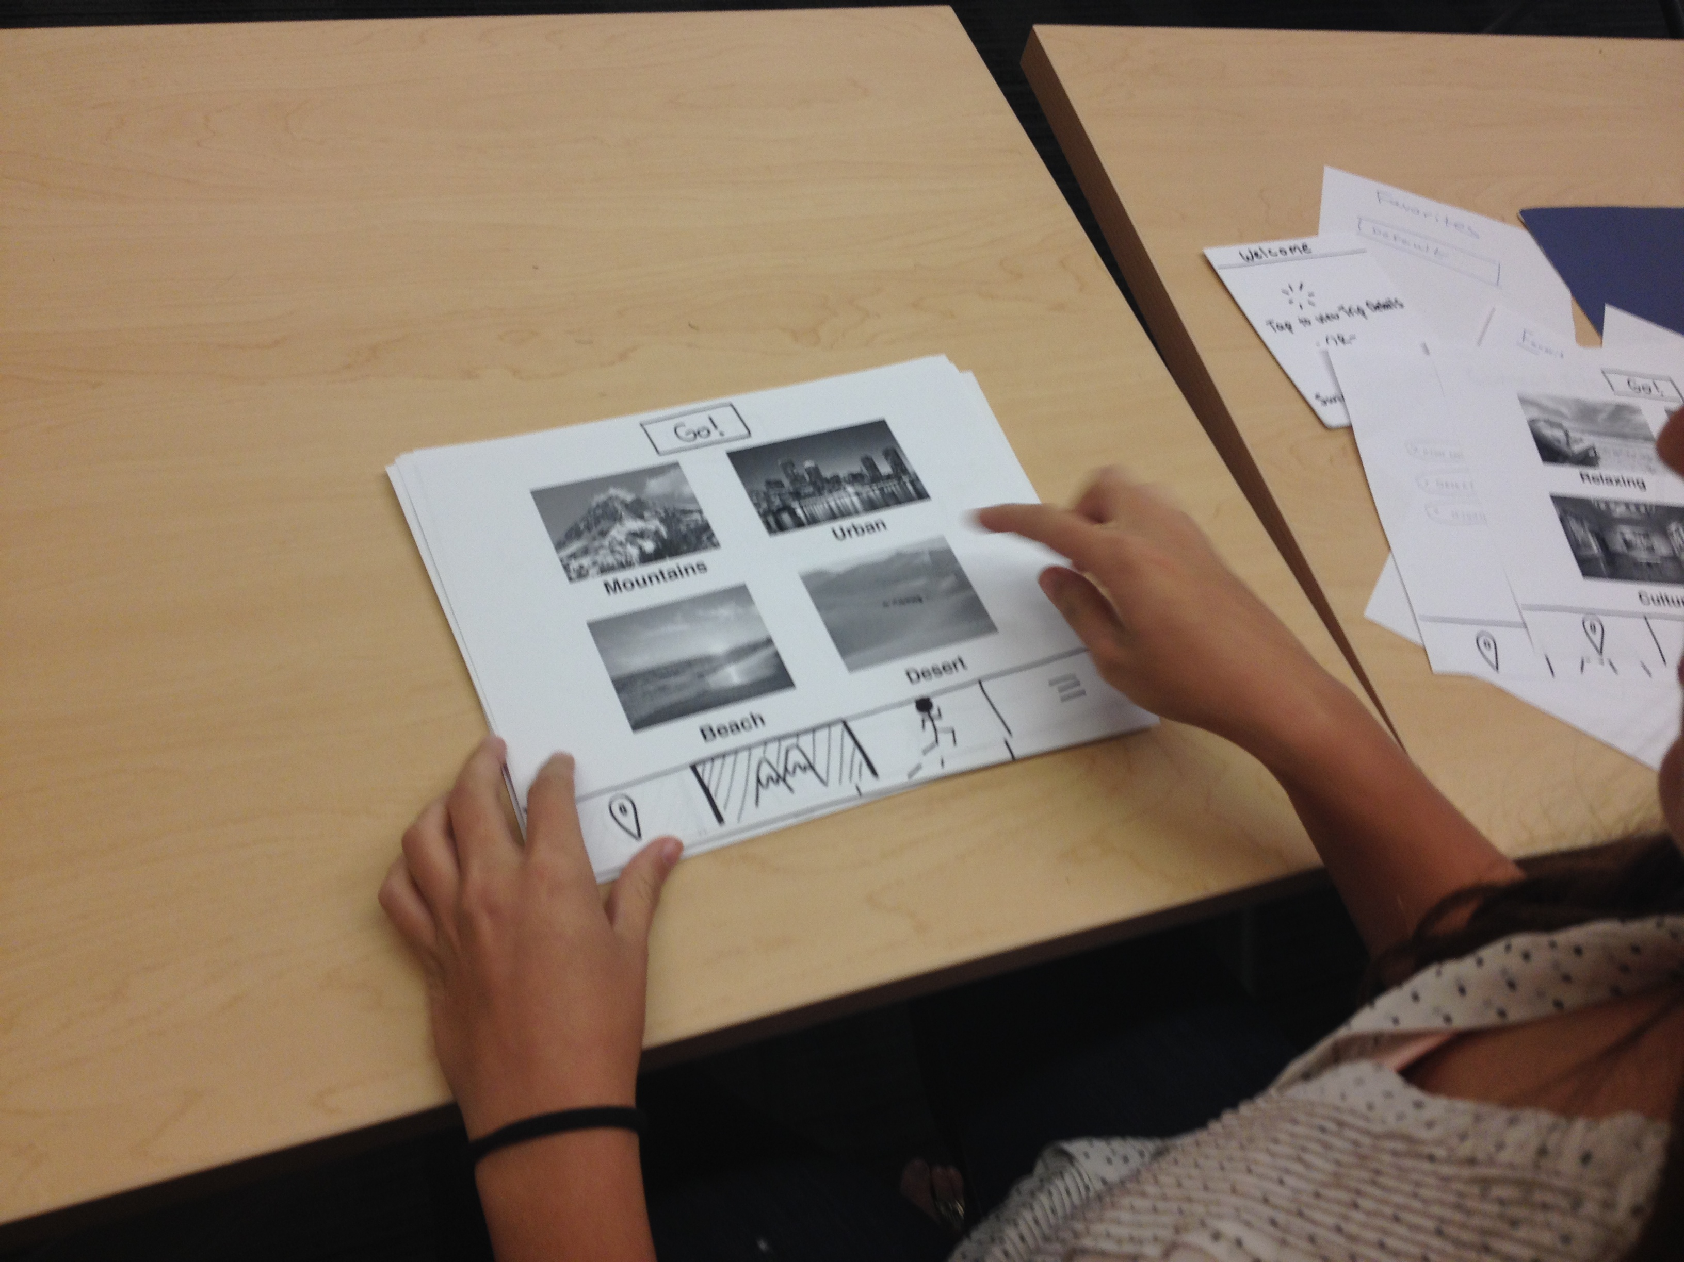
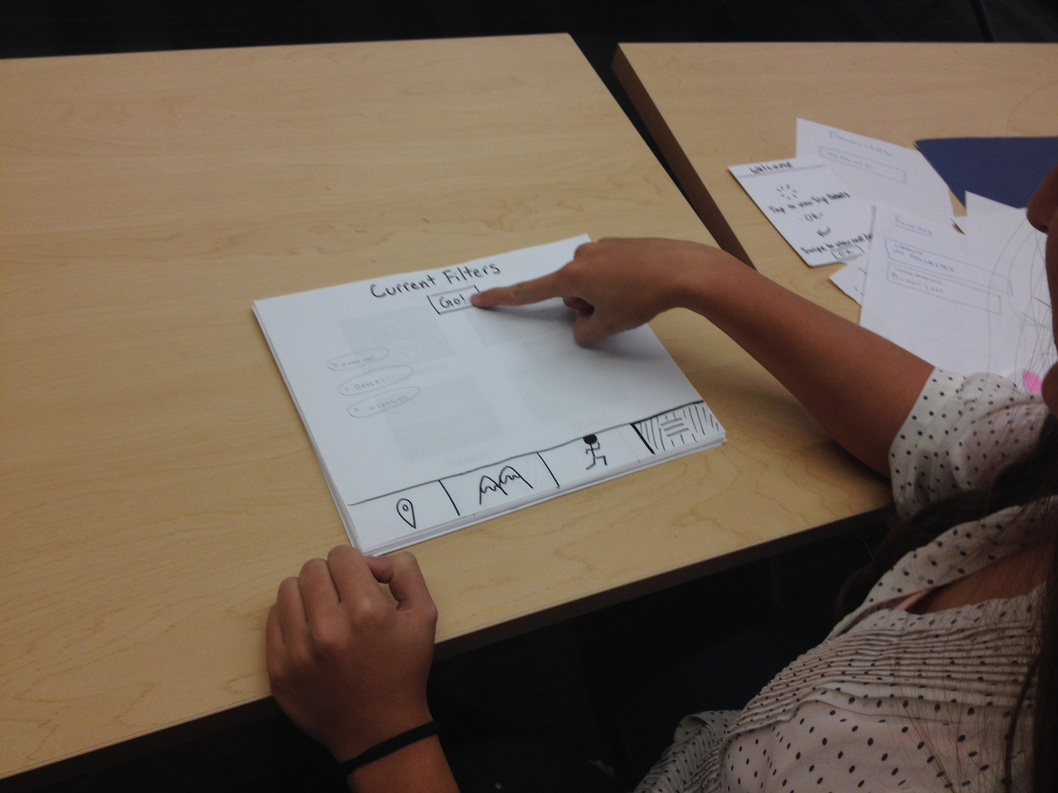
Notes:
Complex Task—> adding filters

Slide 12
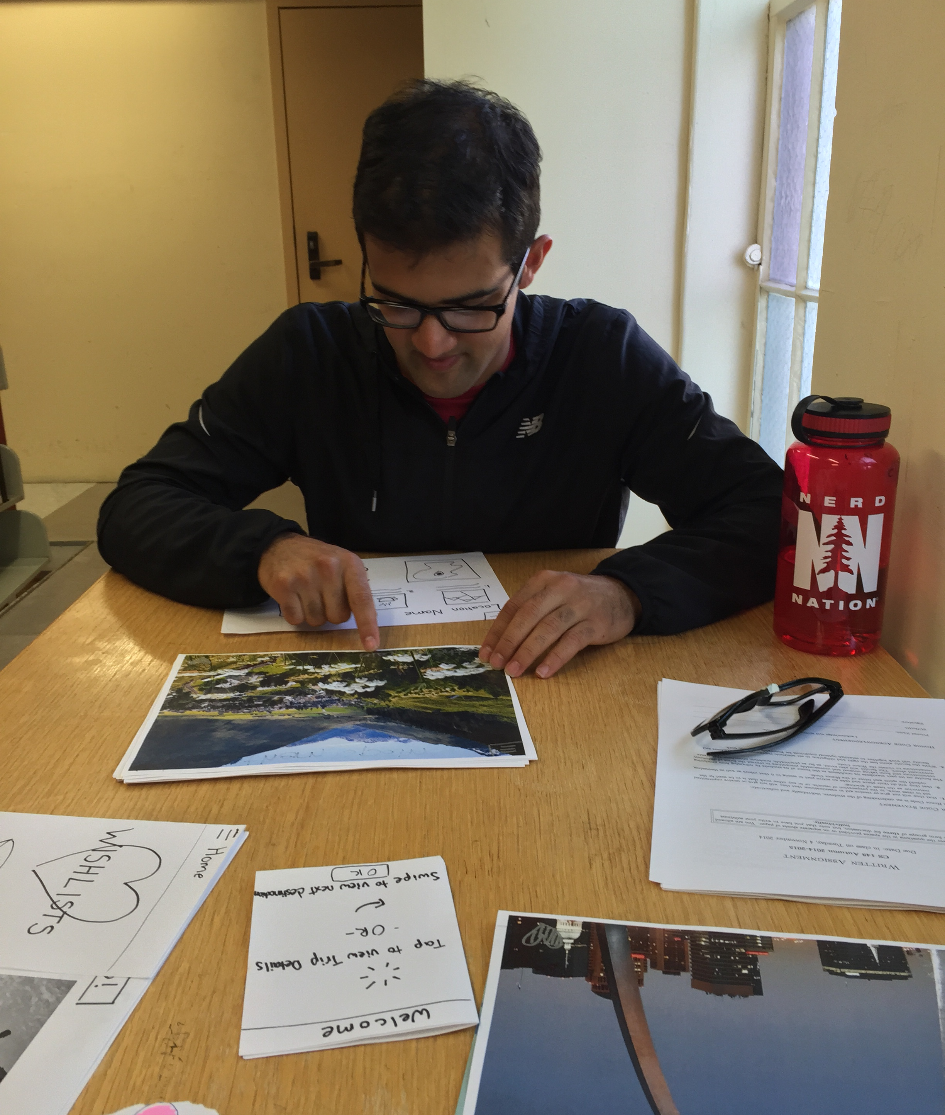
Method
Let them explore page
Ask expectations of the page
Did the page meet expectations
Notes:
experimental method

Slide 13
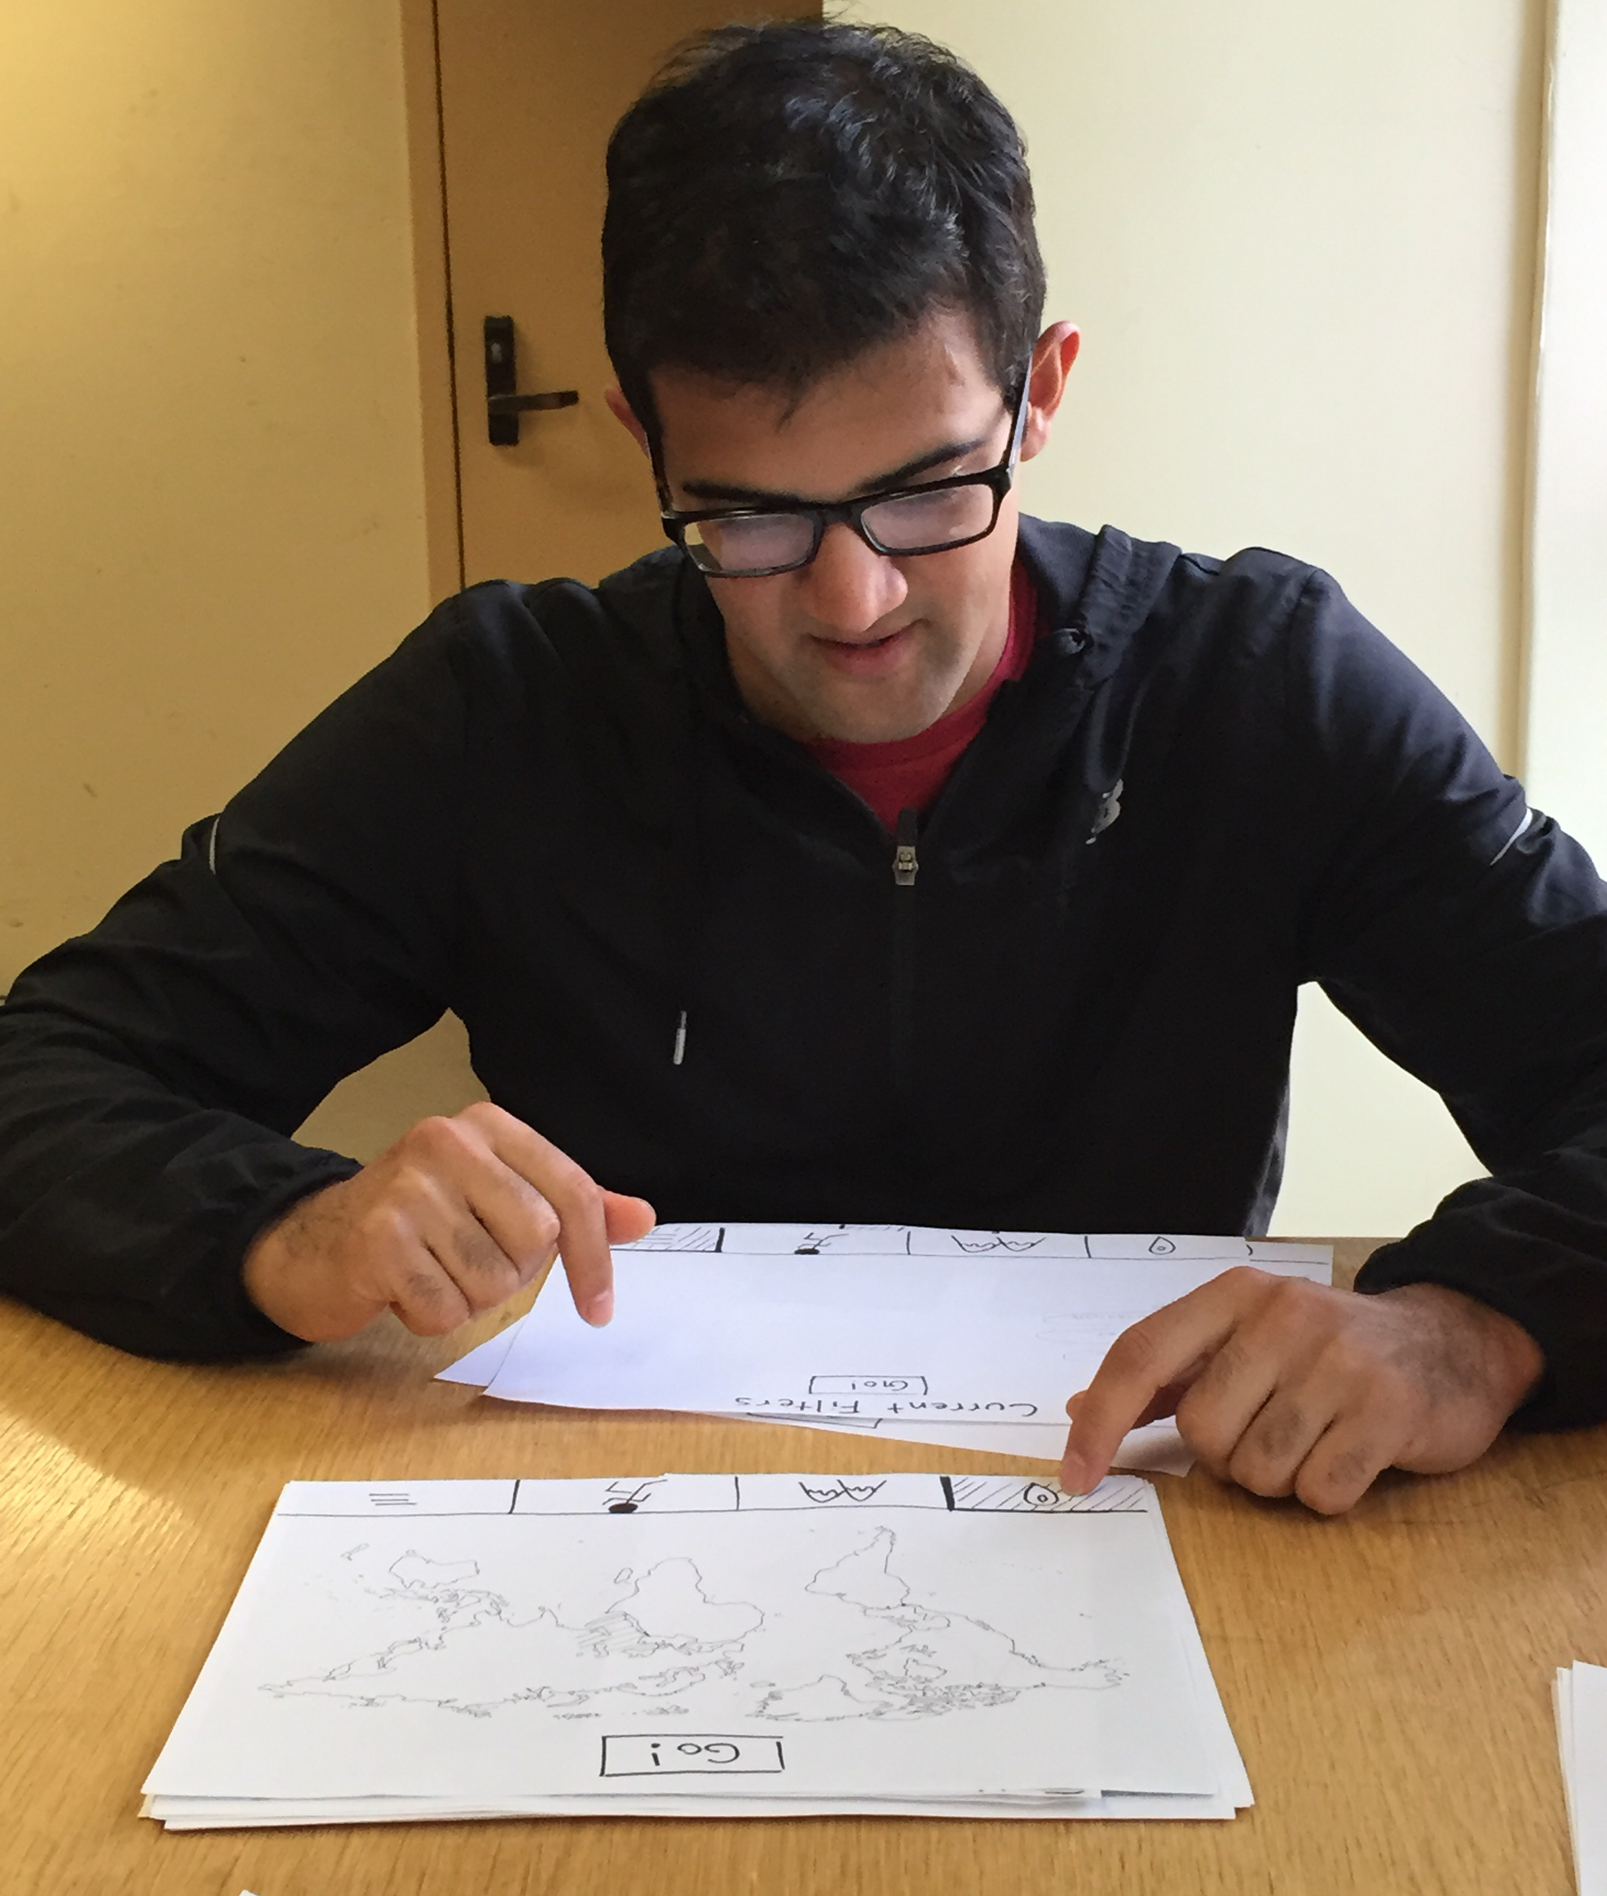
Results
Complicated filter
Visual component appreciated
Correct level of information
Notes:
experimental results

Slide 14
Add notes to wish lists
Notes:
suggested UI changes #3
create notes about lists and trips

Slide 15
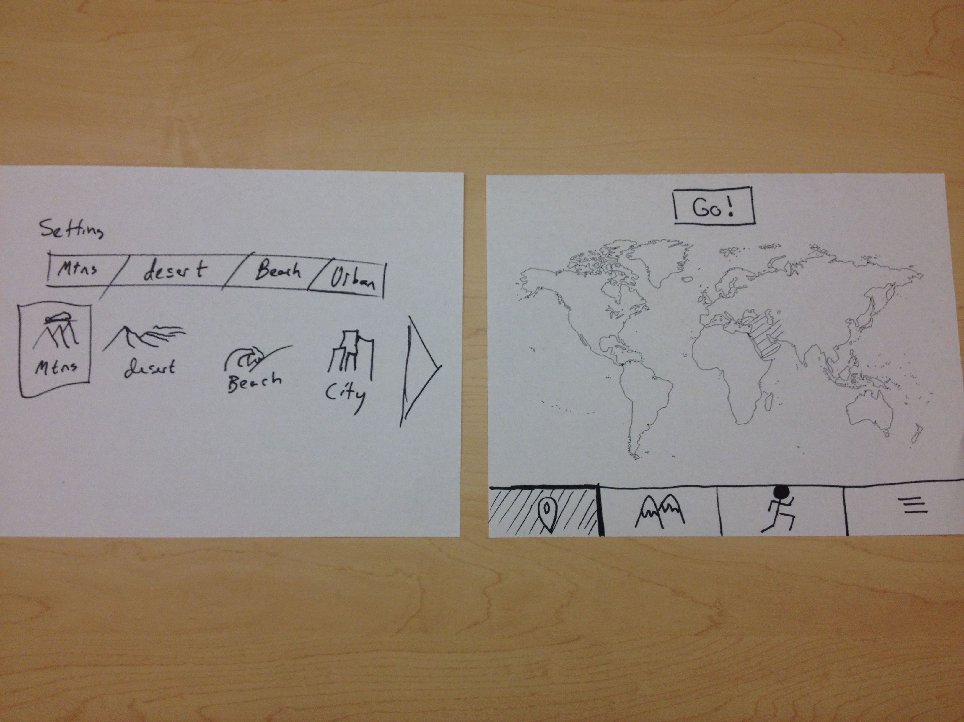
Simplified Filter
Notes:
suggested UI changes #1
—>simplify FILTERS

Slide 16
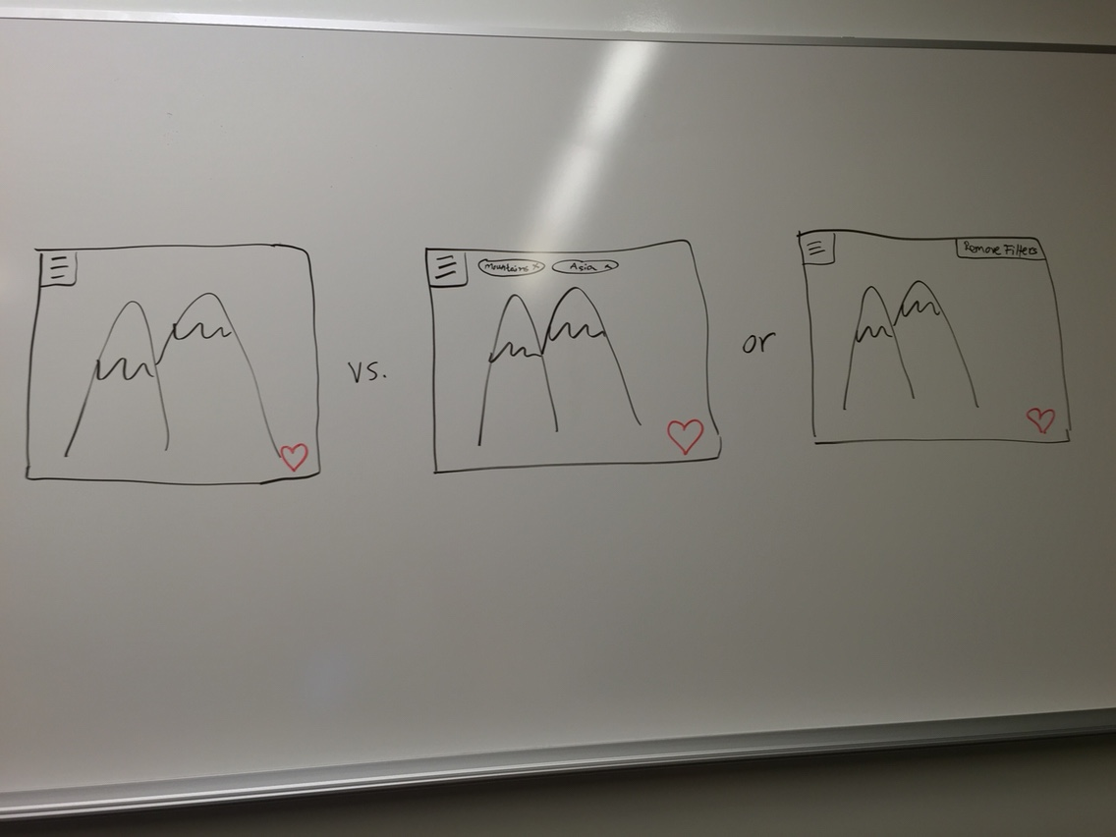
Add Filters to Page
Notes:
suggested UI changes #2
—>add filters to the page

Slide 17
We want to…
simplify filters page
make current filters visible
add notes

